Slide 1


KOSANAM YASHWANTH

Slide 2
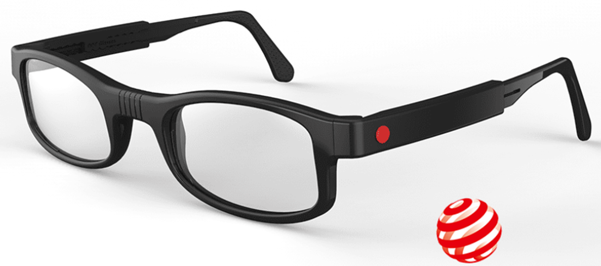



COMPANY FEATURES
Lowest end to end costs
Easy Training
No optometrist required
The glasses that this company provides completely cost free and available for poor people
The training is no much needed ,because the usage of this product is very simple to use.
No need of any doctor , along with the kit and instructer will visit your place and make awareness about the product

Slide 3
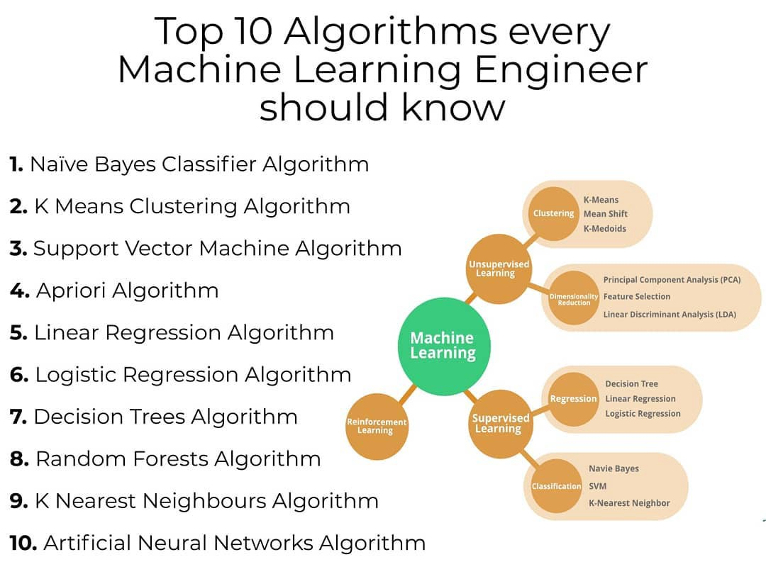

This solution is well-suited and highly applicable in lower case countries that lack the necessary vision care professionals and supply chains to provide perfect vision correction solutions
It is the big benefit of the simplicity of solution , adjustable one-size-fits-all design , high-quality of the lenses , low costs and good looks, it is the perfect correction for both myopia and presbyopia.
Swot Analysis
Dot glasses has a well-thought-out business plan that offers an interesting business opportunity in addition to fulfilling an obvious charitable purpose.

Slide 4
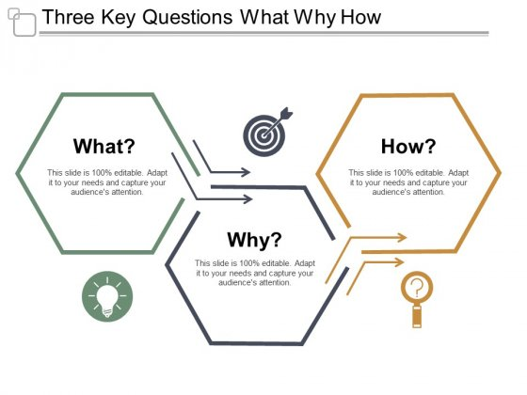
To predicate
the sales from different points and figure out the dark store on better for delivery and
predict the sales and demand for the same to make operations scalable.
Warehouse prediction using K-means clustering algorithms to detect
common patterns in unorganized data points.
To increase the sales of the product and to supply the product to each and every location and with fast delivery.

Slide 5

Enter Text Here
Enter Text Here
Enter Text Here
Enter Text Here
Enter Text Here
Enter Text Here
Enter Text Here
Enter Text Here
Enter Text Here
INSERT LOGO HERE

Slide 6

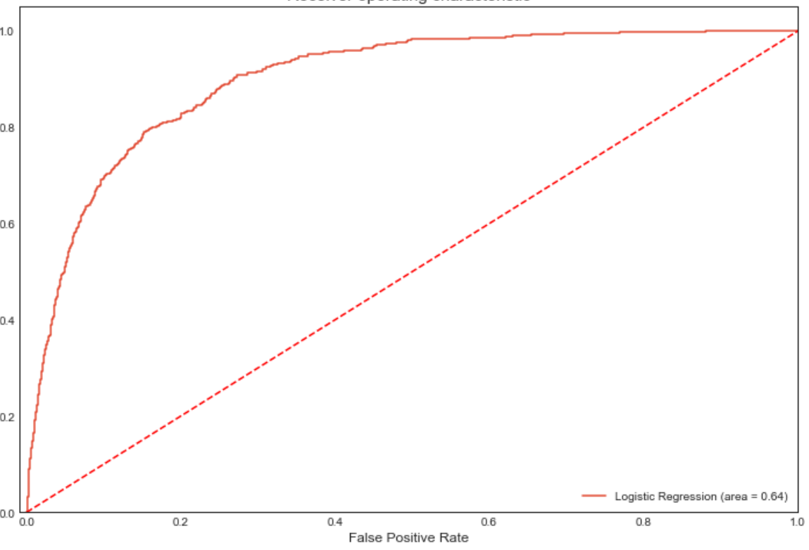

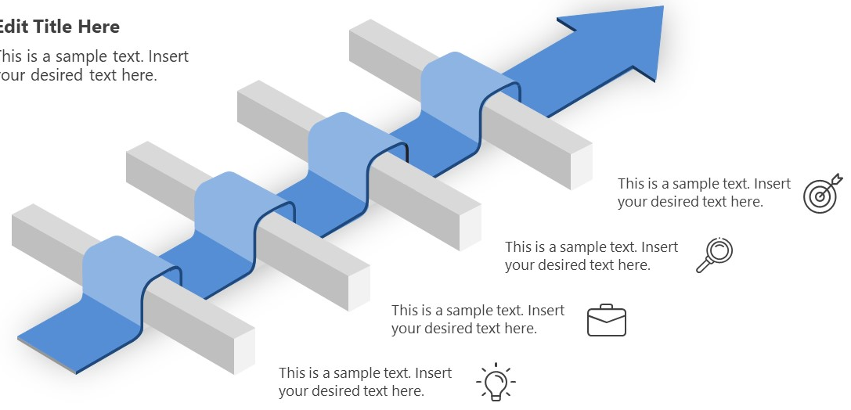
Task 2
Task 1
Performed statistical analysis for the bank data.
Analyzed the data and identified the useful attributes from the dataset.
Created different classification models and among them rondomforest model gives the best accuracy
Achieved the beat model for the give objective.
Built different models and did model evaluation.
EDA analysis and created new features for the bank data.
Collected data from the different sources.

Slide 7
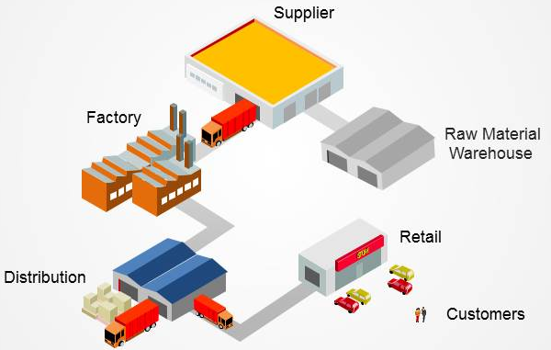
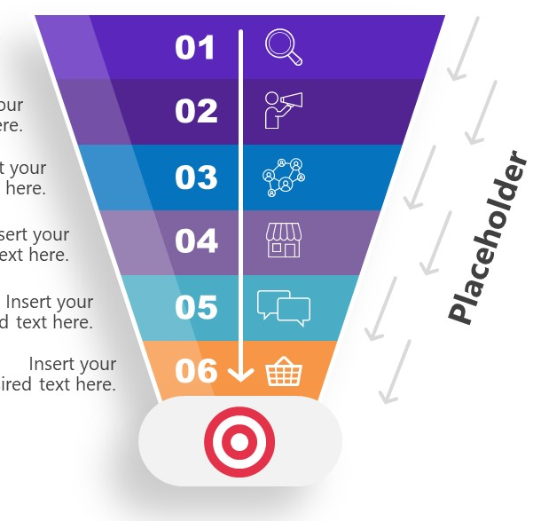
Learnt and discussed about the importance of dark stores and it’s role in the retail market business.
Also presented the order processing and the advantages of dark store an the ways to improve the efficiency of a company.
Performed a machine learning unsupervised learning algorithm on a retailer data of a Big Bazaar company and predicted the number of clusters for each and every product in the company according to their number of sales
Task 3
Task 4
Collected data from the different sources.
Performed different data cleaning techniques on the given data
Created new features and performed the relation between the product.
Created the new feature according to the nearest warehouse.
Built the model according to the type of product using clustering.
Achieved the best model for the given problem.

Slide 8


